Slide 1
Industrial Combustion Energy Use
Mentors
Shubham Kabre
Gowrishankari Padmanathan
Team
Avinash Patil | My SQL, Tableau 1 and Power BI
Akshay Bhole | Tableau 1
Prasad Jadhav | My SQL
Sagar Wadile | My SQL, Power BI
Sumanth Udupi | Excel, Tableau 2 and PPT
Swaraj Dorge | Presentation

Slide 2
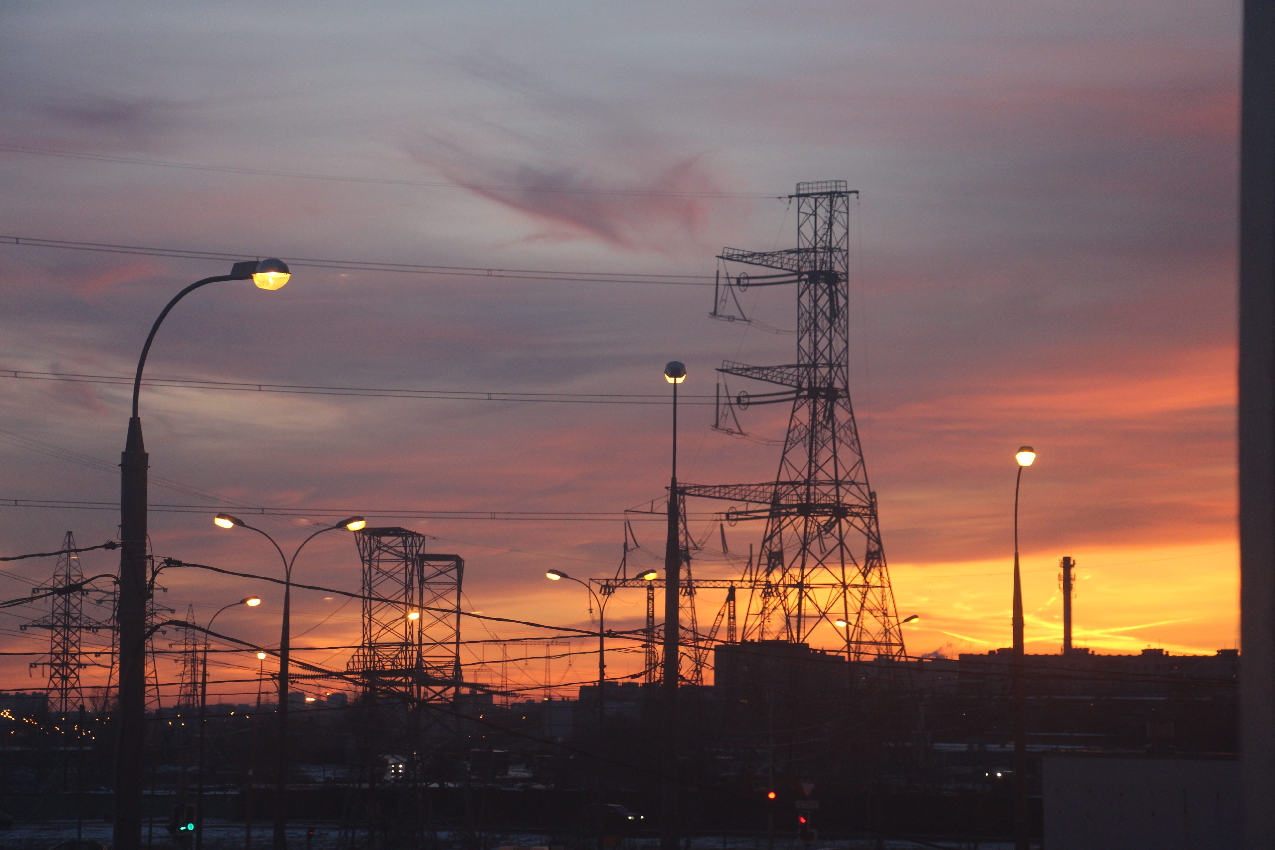
MMBtu_TOTAL for Ethane & Ethanol
MMBtu is acronym for Metric Million British Thermal Unit, and it is a unit traditionally used to measure heat content or energy value.
When a comparison is made between Ethane and Ethanol for total MMBTU.
Total for Ethane is 5559800.336 and Ethanol is 84129.16423.
Between Ethane and Ethanol, Ethane is used 97% more than Ethanol 100.
Mont Belvieu Fractionators facility has highest MMBTU total for Ethane.
The Dow Chemical Company is the only facility that uses Ethanol.

Slide 3
Process Heating for 3M Company Facility
3M Company Facilities | Process Heating
Process Heating for 3M MAGNETIC TAPE MANUFACTURING DIVISION | 134.8175934
Process Heating for 3M BROWNWOOD | 531.8543017
Process Heating for 3M CO - GUIN | 531.8543017
Process Heating for 3M COMPANY | 11125.51282
Process Heating for 3M CORDOVA | 1018.049373
Process Heating for 3M Cottage Grove Center - Site | 1018.049373
Process Heating for 3M INDUSTRIAL MINERAL PRODUCTS DIVISION | 478.5520358
Process Heating for 3M NEVADA PLANT | 531.8543017
Process Heating for 3M CO - WAUSAU DOWNTOWN | Data unavailable
Process Heating for 3M CO | Data unavailable
Total | 15370.5441
Average | 1921.318013
Process Heating for 3M COMPANY is 11125.51282.
3M COMPANY has the highest process heating in comparison to other 3M Facilities.
3M COMPANY is 72% of the total Process heating for 3M Facilities.

Slide 4
Unit Name trend (1950-2022) Vs GWht_TOTAL
Gigawatt hours, abbreviated as GWh, is a unit of energy representing one billion (1 000 000 000) watt hours and is equivalent to one million kilowatt hours.
5-Aug-2022 had the highest GWh Total of 1715.718869
01-Sep-2022 is the lowest GWh Total 0.00466157 .

Slide 5
% Share of Direct Uses-Total Non-process for each MECS_Region
Direct Uses-Total Non-process is the highest in South region with 40% .
As there is 7673 number of facilities it has the highest share.
Direct Uses-Total Non-process is the lowest in Northeast region 11%.
As there is 2788 number of facilities it has the lowest share.

Slide 6
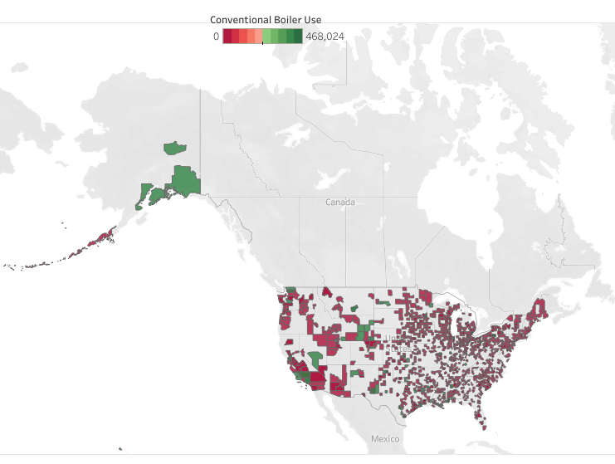
County wise Conventional Boiler Use Stats
Hawaii has one of the highest average Conventional Boiler Use.
Ohio has one of the highest sum Conventional Boiler Use.
Wyoming has one of the highest Conventional Boiler Use.
Indiana has one of the lowest Conventional Boiler Use.
Alaska has one of the highest Std Dev of Conventional Boiler Use.

Slide 7
Thank you

